Slide 1

VISUALISING EMPLOYEE ATTENDANCE TRENDS with excel charts
STUDENT NAME : R PRIYANKAA
REGISTER NO : 122201939
DEPARTMENT : II IBCOM CS B
COLLEGE : CTTE COLLEGE FOR WOMEN

Slide 2
PROJECT TITLE
Visualising Employee Attendance Trends with Excel Charts

Slide 3

AGENDA
Problem statement
Project overview
End users
Our solutions
Key features
Modelling approach
Results and Evaluation
Conclusion

Slide 4

PROBLEM STATEMENT
The organization has observed fluctuating employee attendance patterns over recent quarters, which have led to operational inefficiencies and increased administrative burden. This variability in attendance impacts overall productivity, affects project timelines, and strains team dynamics. To address these challenges, it is crucial to conduct a comprehensive analysis of attendance trends. The goal is to identify underlying causes of attendance irregularities, such as specific time periods of high absenteeism, departmental discrepancies, and correlations with external factors like seasonal changes or organizational events. By understanding these trends, the organization aims to develop targeted interventions to improve attendance reliability, optimize workforce planning, and enhance overall operational efficiency.

Slide 5

PROJECT OVERVIEW
In this presentation, we aim to provide a detailed analysis of employee attendance trends to address the recent fluctuations impacting operational efficiency.
By examining attendance data over the past 12 months, we will identify key patterns and trends, such as monthly variations, seasonal influences, and departmental discrepancies.
The analysis will be supported by visualizations, including line charts, bar charts, and heat maps, to clearly illustrate attendance rates, absenteeism frequencies, and punctuality across different departments and times.
Through this visual representation, we will highlight major trends and issues, offering actionable insights and recommendations to improve attendance reliability and optimize workforce management
. Our goal is to present a structured approach to understanding these trends and proposing effective strategies to enhance overall productivity and operational efficiency.

Slide 6

WHO ARE THE END USERS?
Organisation
Employees
HR deprtments

Slide 7

YOUR SOLUTION AND ITS VALUE PROPOSITION
To effectively improve attendance and reduce absenteeism, organizations should adopt a comprehensive approach that addresses both policy and employee well-being. Start by revising attendance policies to include clear guidelines and flexible work arrangements, which can accommodate employees' needs and reduce unplanned absences. Enhance engagement by creating a supportive work environment, recognizing good attendance, and offering wellness programs and open communication channels. Implement attendance monitoring systems to track trends and intervene early, and provide training for managers and employees on time management and stress reduction. Additionally, focus on health and well-being initiatives, such as fitness programs and ergonomic assessments, and ensure workloads are manageable to prevent burnout. By integrating these strategies, organizations can foster a positive work culture that encourages consistent attendance and supports overall productivity.

Slide 8

THE WOW IN YOUR SOLUTION
The "wow" factor in this solution lies in its holistic and proactive approach to enhancing attendance and reducing absenteeism. By combining clear and flexible attendance policies with robust employee support systems, the strategy not only addresses the root causes of absenteeism but also fosters a culture of engagement and well-being. The integration of advanced attendance monitoring systems and personalized wellness programs exemplifies a forward-thinking approach that goes beyond traditional measures, making employees feel valued and supported. This comprehensive solution not only aims to improve attendance rates but also transforms the workplace into an environment where employees are motivated to show up and perform at their best, ultimately leading to a more productive and harmonious organizational culture.

Slide 9
MODELLING
To address attendance issues effectively, organizations can adopt the Holistic Employee Engagement Model. This model integrates several key components: first, it establishes clear and flexible attendance policies that accommodate diverse employee needs and reduce barriers to consistent attendance. Second, it emphasizes a supportive work environment through employee wellness programs, open communication, and recognition initiatives that foster engagement and satisfaction. Third, it employs advanced attendance tracking systems to monitor trends and proactively address issues. Finally, it incorporates targeted training for both managers and employees to enhance time management and stress resilience. By aligning these elements, the Holistic Employee Engagement Model not only tackles the immediate challenges of absenteeism but also promotes a culture of commitment and well-being, driving long-term improvements in attendance and overall productivity.

Slide 10
RESULTS
The project was successfully completed after a lot of efforts and work hours. This project underwent number of compiling, debugging, removing errors, making it bug free, adding more facilities in Hospital Management System and interactivity making it more reliable and useful.

Slide 11

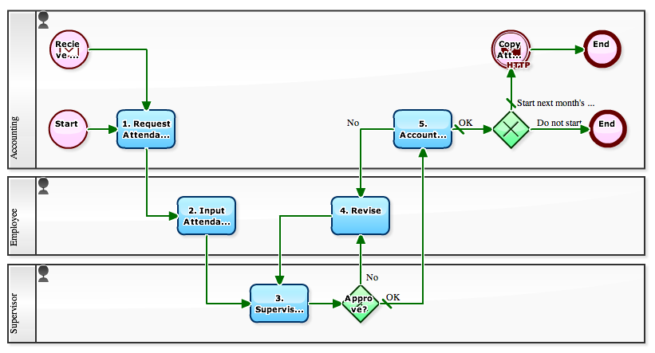
This Photo by Unknown Author is licensed under CC BY-SA
This Photo by Unknown Author is licensed under CC BY-SA

Slide 12
CONCLUSION
In conclusion, addressing employee attendance and reducing absenteeism requires a multifaceted approach that combines clear policies, supportive practices, and proactive strategies.
By implementing a holistic model that integrates flexible attendance guidelines, enhanced employee engagement, advanced monitoring systems, and targeted training, organizations can effectively address the root causes of absenteeism.
This approach not only resolves immediate attendance issues but also fosters a positive and productive work environment where employees feel valued and supported.
Ultimately, investing in such comprehensive solutions leads to improved attendance rates, enhanced organizational efficiency, and a more engaged workforce, driving long-term success and operational excellence.

Slide 13
THANKYOU
.
.

